Slide 1
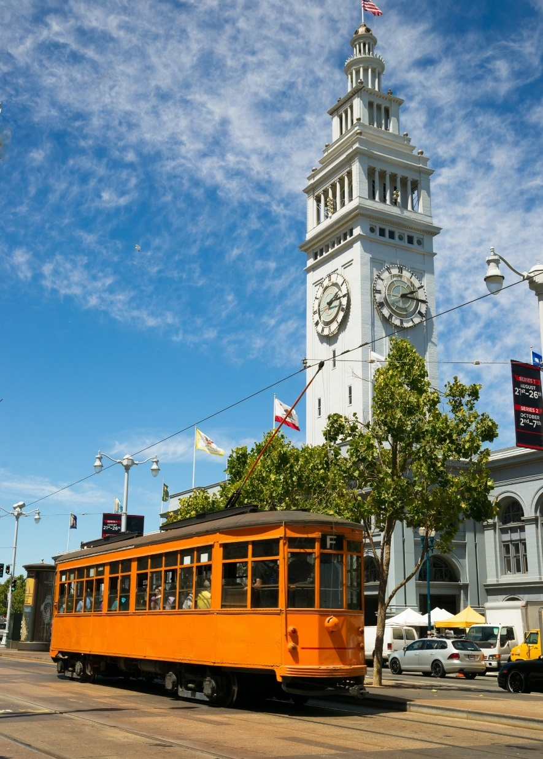

August 21, 2020
WISF Executive Committee
Workforce Director’s Report
San Francisco Office of Economic and Workforce Development www.oewd.org

Slide 2
COVID-19 Unemployment

Slide 3
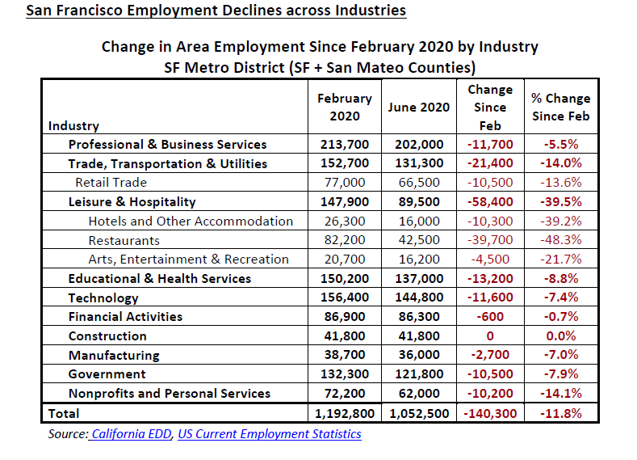

Slide 4
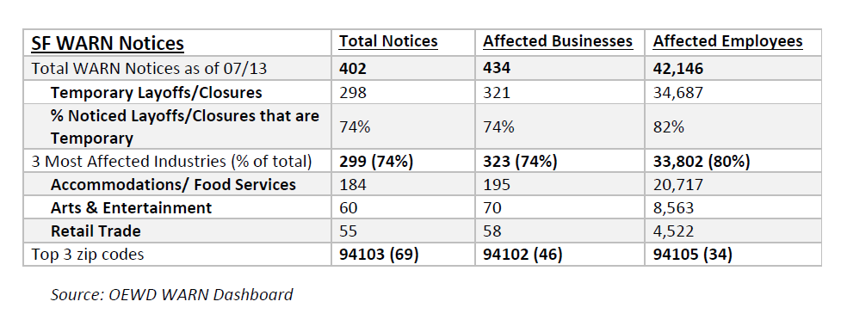

Slide 5

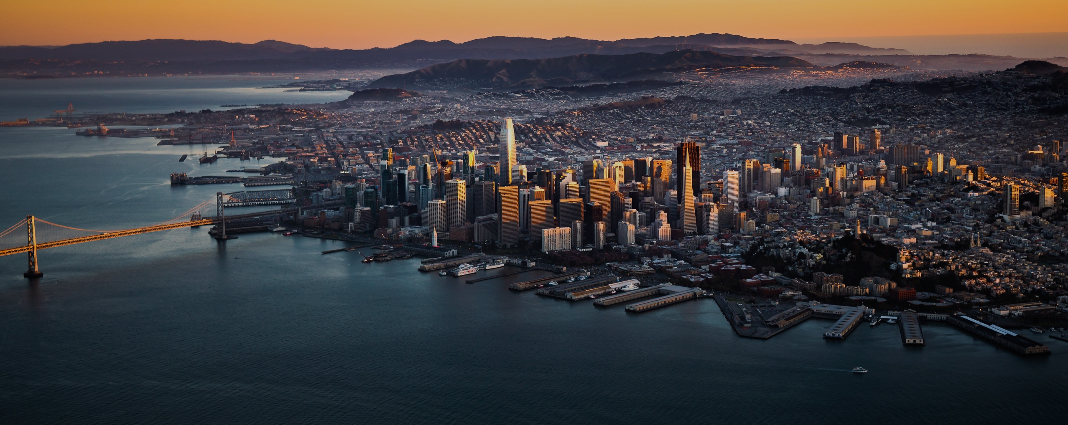

BUDGET
UPDATE
August 13, 2020

Slide 6


1
MISSION & GOALS
The Office of Economic and Workforce Development advances equitable and shared prosperity for San Franciscans by growing sustainable jobs, supporting businesses of all sizes, creating great places to live and work, and helping everyone achieve economic self-sufficiency.
GOALS
Facilitate a resilient, diverse, and robust economy where businesses can start, stay and grow in San Francisco
Create and connect residents to good jobs and strong career pathways
Support vibrant neighborhoods by strengthening small businesses and community organizations
Create space for jobs, affordable housing, recreation, and public use
Budget Update
August 13, 2020

Slide 7
COVID RESPONSE
2
SMALL BUSINESS LOANS & GRANTS
$16.05m | 1,100 businesses
WORKER RELIEF PROGRAMS
$17.48m | 30,978 workers
COMMUNITY OUTREACH
Phone | 2 dedicated hotlines | 10,041 calls/requests
Webinars | > 270 virtual events | > 6,600 participants
Website | 711,681 views | 449% increase | 559,947 visitors | 459% increase
STAFFING RESPONSE
Citywide Response | 25 employees (20% of staff)
Department Response | 40 employees (31% of staff)
 | 27,976 emergency hours logged
Notes:
6.2m Give2SF
4m leveraged private sources (MEDA)
2m rebate
1m initial
860k mini-grants
1m RLF

Slide 8
3
BUDGET OVERVIEW
(MYR PHASE)
BUDGET
Division | FY 2019-2020 | FY 2020-2021 | change from 2019-2020 | FY 2021-2022 | change from 2019-2020
Economic Development | 35,218,113 | 22,005,818 | (13,212,295) | 20,456,773 | (1,549,045)
Film SF | 1,452,390 | 1,452,390 | — | 1,452,390 | —
Office of Small Business | 3,129,487 | 2,770,352 | (359,135) | 2,743,870 | (26,482)
Real Estate Development | 16,761,248 | 17,363,716 | 602,468 | 17,361,392 | (2,324)
Workforce Development | 30,313,293 | 48,283,665 | 17,970,372 | 48,985,617 | 701,952
Total | 86,874,531 | 91,875,941 | 5,001,410 | 91,000,042 | (875,899)
* Finance and Administration budget is reflected under overhead in each Division

Slide 9
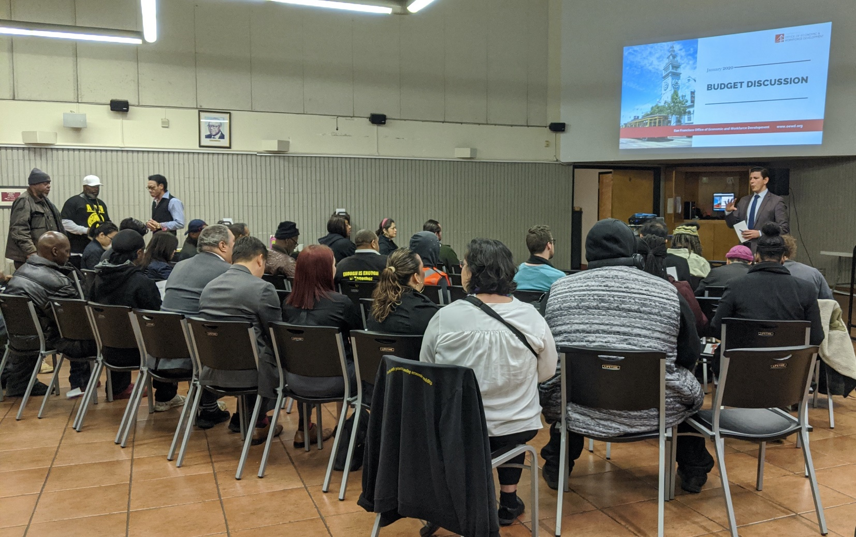
4
APPROACH TO REDUCTIONS
Criteria & Goals
Incorporate community priorities
Stabilize vulnerable populations
Minimize impacts to communities of color
Retain core services
Protect capacity and ongoing work of CBO partners
Adjust to new environment of COVID-19
Preserve investments to achieve an equitable and strong economic recovery
BUDGET UPDATE

Slide 10
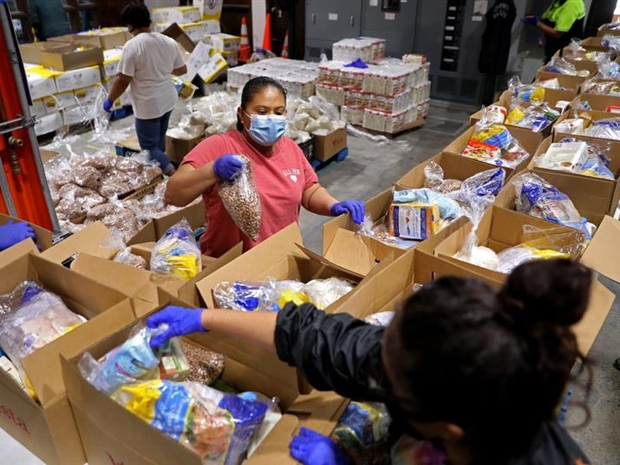

5
LOOKING TO THE FUTURE:
A STRONG AND EQUITABLE RECOVERY
A budget grounded in racial equity
Investments centered in the Black community
Building resiliency in historically disinvested communities
Supporting vulnerable populations
Empowering entrepreneurs and facilitating job creation
Creating inclusive and affordable places to live
Advancing economic justice and inclusion
BUDGET UPDATE

Slide 11
BUDGET
UPDATE
August 13, 2020
www.oewd.org
@sfoewd
(415) 554-6969
oewd@sfgov.org

