Slide 1
2/9 TF Meeting Outcomes
Develop awareness of TF member’s unique value and the importance of this collective process.
Increase awareness about the need to include racial and economic considerations in the generation of TF recommendations.
Increase TF awareness of the TL Community Councils’ Framework for Addressing Disruptive Street Level Drug Dealing.
Street Level Drug Dealing Taskforce

Slide 2
Touchstone Practices
Give and receive welcome.
In this circle we support each other's learning by giving and receiving hospitality, reconnecting to abundance, and remembering there is more than enough for all of to thrive.
All of you is welcome here.
Be here with your purpose, gifts, and strengths and as well as your, doubts, fears and failings, your listening as well as your speaking, your full humanity.
What is offered in the circle is an invitation, you choose how you participate.
Do whatever your soul calls for, and know that you do it with our support. Your soul knows your needs better than we do.
Speak your truth in ways that respect other people's truth.
Our views of reality may differ, but speaking one's truth in this Circle of Purpose does not mean correcting or debating what others say. Speak from your center to the center of the circle, using "I" statements that speak from your own experience, trusting people to do their own sifting and winnowing.
When the going gets rough, turn to wonder.
If you feel judgmental, or defensive, ask yourself, "I wonder what brought her to this belief?" "I wonder what he's feeling right now?" "I wonder what my reaction teaches me about myself?" Set aside judgment to listen to others-and to yourself-more deeply. Get curious and make space.
Learn to respond to others with honest, open questions.
With such questions, we help "hear each other into deeper speech."
Attend to your own inner teacher.
We learn from others, of course. And, as we explore in our Circle of Purpose, we have a special opportunity to learn from within. We invite you to listen to your intuition; your inner wisdom is your most important teacher.
Street Level Drug Dealing Taskforce

Slide 3
Reminders and look forward
Each of you are here for a unique reason, and each perspective is valuable.
We cannot be successful in a vacuum, this work requires collaboration.
“Failure is our greatest teacher.” - Yoda
Street Level Drug Dealing Taskforce

Slide 4
Task Force purpose
To advise the Board of Supervisors, the Mayor, and City departments regarding policies to address harms related to street-level drug dealing in the Tenderloin, Civic Center, Mid-Market, and South of Market neighborhoods.
Street Level Drug Dealing Taskforce

Slide 5
TF Legislative Responsibilities
In conducting the assessments and making recommendations required, the TF shall consider:
Best practices and approaches from other jurisdictions;
Perspectives of those most deeply affected by the harms associated with street-level drug dealing;
Strategies beyond street level enforcement, including intelligence-led and high visibility policing;
The Task Force shall seek to recommend achievable, systems-level, trauma-informed, data- and evidence-based policy and administrative solutions through a racial and economic equity lens that will have a short-term and long-term impact on the community.
Street Level Drug Dealing Taskforce

Slide 6
Resources
Foundational Principles Central to Harm Reduction, National Harm Reduction Coalition
https://harmreduction.org/about-us/principles-of-harm-reduction/
“Effectiveness vs. Equity in Policing: is a Tradeoff Inevitable?”, National Police Foundation
https://www.policefoundation.org/publication/effectiveness-vs-equity-in-policing-is-a-tradeoff-inevitable/
Street Level Drug Dealing Taskforce

Slide 7
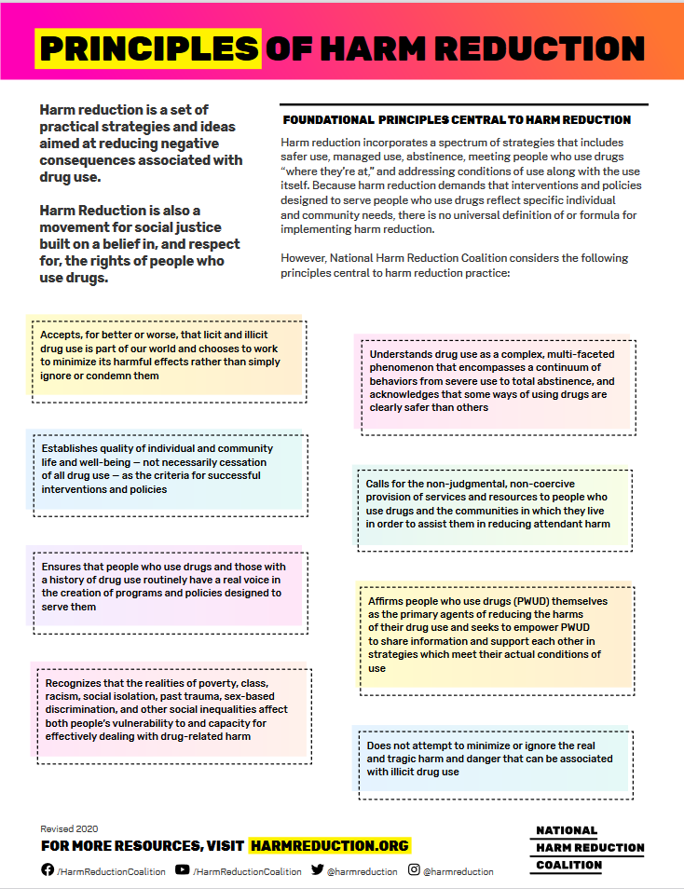

Slide 8
Tenderloin Community Council: Strategic Approach to Addressing Harms Related to Open Air Drug Market
Presented by
Sam Dennison
February 9, 2021

Slide 9
Purpose:
Provide a framework for an actionable plan for the short-term & long-term

Slide 10
TL Community Council
Formed in Spring 2019
In-person meetings 20-25 people
TL residents, business owners, non-profit
Each mtg 30% to 60% POC
Long term residents--many in the TL for 10+ years.

Slide 11
TL Community Council Purpose
Honest talk among the multiple communities of the TL
Identify harms related to open-air drug sales and use
Review, evaluate, and advocate for effective ways to address those harms

Slide 12
TL Community Council
Participated in City Hearings April 2019
Negotiated for broader representation on this Task Force
Negotiated framing the issue as addressing harms and not just sales

Slide 13
URGENCY TODAY
INCREASES IN VIOLENCE
INCREASES IN OVERDOSES
COVID HAS CHANGED WHO IS ON THE STREETS AND FOR WHAT PURPOSE
LOSS OF LIFE, LOSS OF BUSINESS, LOSS OF STABILITY

Slide 14
Assumptions
The drug market has existed for decades and impact is getting worse
The TL is a traumatized community
These conditions didn’t occur overnight, are deeply entrenched, & require a strategic approach/plan

Slide 15
Further Assumptions
Law enforcement & treatment are equally
important
Participants in the market must be engaged
Success should be measured objectively and subjectively
This problem can’t be dealt with in isolation
Chronic, wide-spread poverty is a driver

Slide 16
HARMS & CONCERNS RELATED TO OPEN AIR DRUG MARKET
INTERFERENCE WITH DAILY LIFE
FOR MEMBERS OF THE COMMUNITY INCLUDING
YOUTH, BUSINESSES, FAMILIES,
PEOPLE IN RECOVERY
ERRODED COMMUNITY IMAGE
VIOLENCE
UPREDICTABLE BEHAVIORS
IMPLIED OR THREATENED
ACTUAL
PROPERTY LOSS
INCLUDING THEFT AND GRAFFITTI
OPEN AIR
DRUG MARKET
RELATED TO USING & BEING HIGH
RELATED TO WITHDRAWL
MENTAL HEALTH
ISSUES
DETERIORATING PUBLIC HEALTH
VISIBLE: OVERDOSES, VISIBLE WOUNDS
INVISIBLE: HEP C, etc.

Slide 17
HARMS & CONCERNS RELATED HIGH RATES OF POVERTY
INTERFERENCE WITH DAILY LIFE
FOR MEMBERS OF THE COMMUNITY INCLUDING
LACK OF ADEQUATE RESOURCES & OPPORTUNITY, CONGESTED SIDEWALKS, INSTABILTY, LACK OF ECONOMIC
VIOLENCE
UNPREDICTABLE
BEHAVIORS
IMPLIED OR THREATENED
ACTUAL
SEXUAL VIOLENCE, PARTNER VIOLENCE
PROPERTY LOSS
INCLUDING
THEFT AND GRAFFITTI
POVERTY
HOMELESSNESS
RELATED TO TRAUMA
RELATED TO UNTREATED MENTAL HEALTH CONCERNS
DETERIORATING PUBLIC HEALTH
VISIBLE: OBESITY OR MALNURISHMENT, MOBILITY ISSUES
INVISIBLE: SHORTENED LIFE EXPECTANCY

Slide 18
Race and Racism :
Chronic under investment and over enforcement have created on-going, chaotic conditions in the TL. These conditions are, in part, the result of historical racism and on-going structural racism.
Any initiative to address open-air drug market will be more effective if accompanied by public race conscious process.
If we want a process of accountability and repair to be effective in changing conditions in the neighborhood, it will have to include a commitment to economic repair and investment for addressing the historical harms of racism.

Slide 19
Recommendation:
A plan that is
Actionable & Effective
Multifaceted
Builds on existing resources
Accountable to diverse communities within the TL

Slide 20
Trauma
Informed Systems
Harm Reduction
Trauma changes behavior
When it’s not possible to eliminate harmful behavior, strategies for reducing harm set the stage for meaningful change
Interventions built on trauma informed systems
maximize success
Police Engagement
Action Plan
& Resources
Leading to
short-term and
long-term improvements
Policing for community stability first and drug market disruption second:
Predictable police presence,
Security from violence,
Restorative
Justice
Many harms caused by the drug market aren’t adequately addressed by the court system.
3. Community & service collaboration.
Anti-violence
Programing
Cycles of violence
fuel the drug market. Intervening before violence occurs & after
it occurs is necessary
Unaddressed harms lead to cycles of violence and drug use

Slide 21
Next Steps
Coordinating Existing Resources
SHORT TERM 3 TO 6 MONTHS
Coordinate existing community based services/resources & law Enforcement
Create strategy & coordinating body
Identify short-term, high priority goals
Community stakeholders (residents, business, etc.)
Community based orgs
City agencies (enforcement, health, etc.)
By location
For maximum improvement
Improve communication & coordination with enforcement.
Map & align existing harm reduction, outreach, safety, cleaning services.
View efforts as neighborhood wide & build on local resources.
Build on COVID related initiatives to maximize short-term outcomes
Safe Streets
TL Plan
HSOC & HOT resources

Slide 22
Next Steps
What Does Short-term action look like?
Coordinated Efforts
Support existing calming activities (police, HSOC, HOT, etc.)
Prepare other resources for immediate activation to maintain calm through presence and services to follow on calming activities
Monitor the area for upticks in activity
Respond to upticks with appropriate resources (enforcement, HSOC, etc.)
Supporting Existing Successes
At safe sleeping sites and existing encampments focus efforts on maintaining and enhancing safety and calm
Use outreach teams with credibility to monitor and address problems
Enhance harm reduction, street medicine and other services

Slide 23
Next Steps
Build Community Based/Supported Long-term Plan
SHORT TERM 6 TO 12 MONTHS
Monitor & support coordinated existing initiatives
Strategy & Coordinating Body
Produce strategic plan incorporating Task Force priorities & strategies
Define 3 to 5 year goals
Identify & advocate for resources
Use short-term efforts to build strategies to develop long term goals and plans
Coordinate with Supervisor’s office on funding and resource strategies
Coordinate non-profit, City (DPH, HSH, etc.), and enforcement agencies/resources
Design evaluation and accountability

Slide 24
Public Comment Remote Access Information
Street Level Drug Dealing Taskforce
Multiple ways to provide public comment:
During TF Meeting:
Opportunities to speak during the public comment period are available via phone at (415) 655-0001, access code [146 450 9707].
Confidential Email: district6ideas@gmail.com
Confidential Text: (415) 483-9005

